Slide 1
Waterway-sunrise-ii_653B

Slide 2
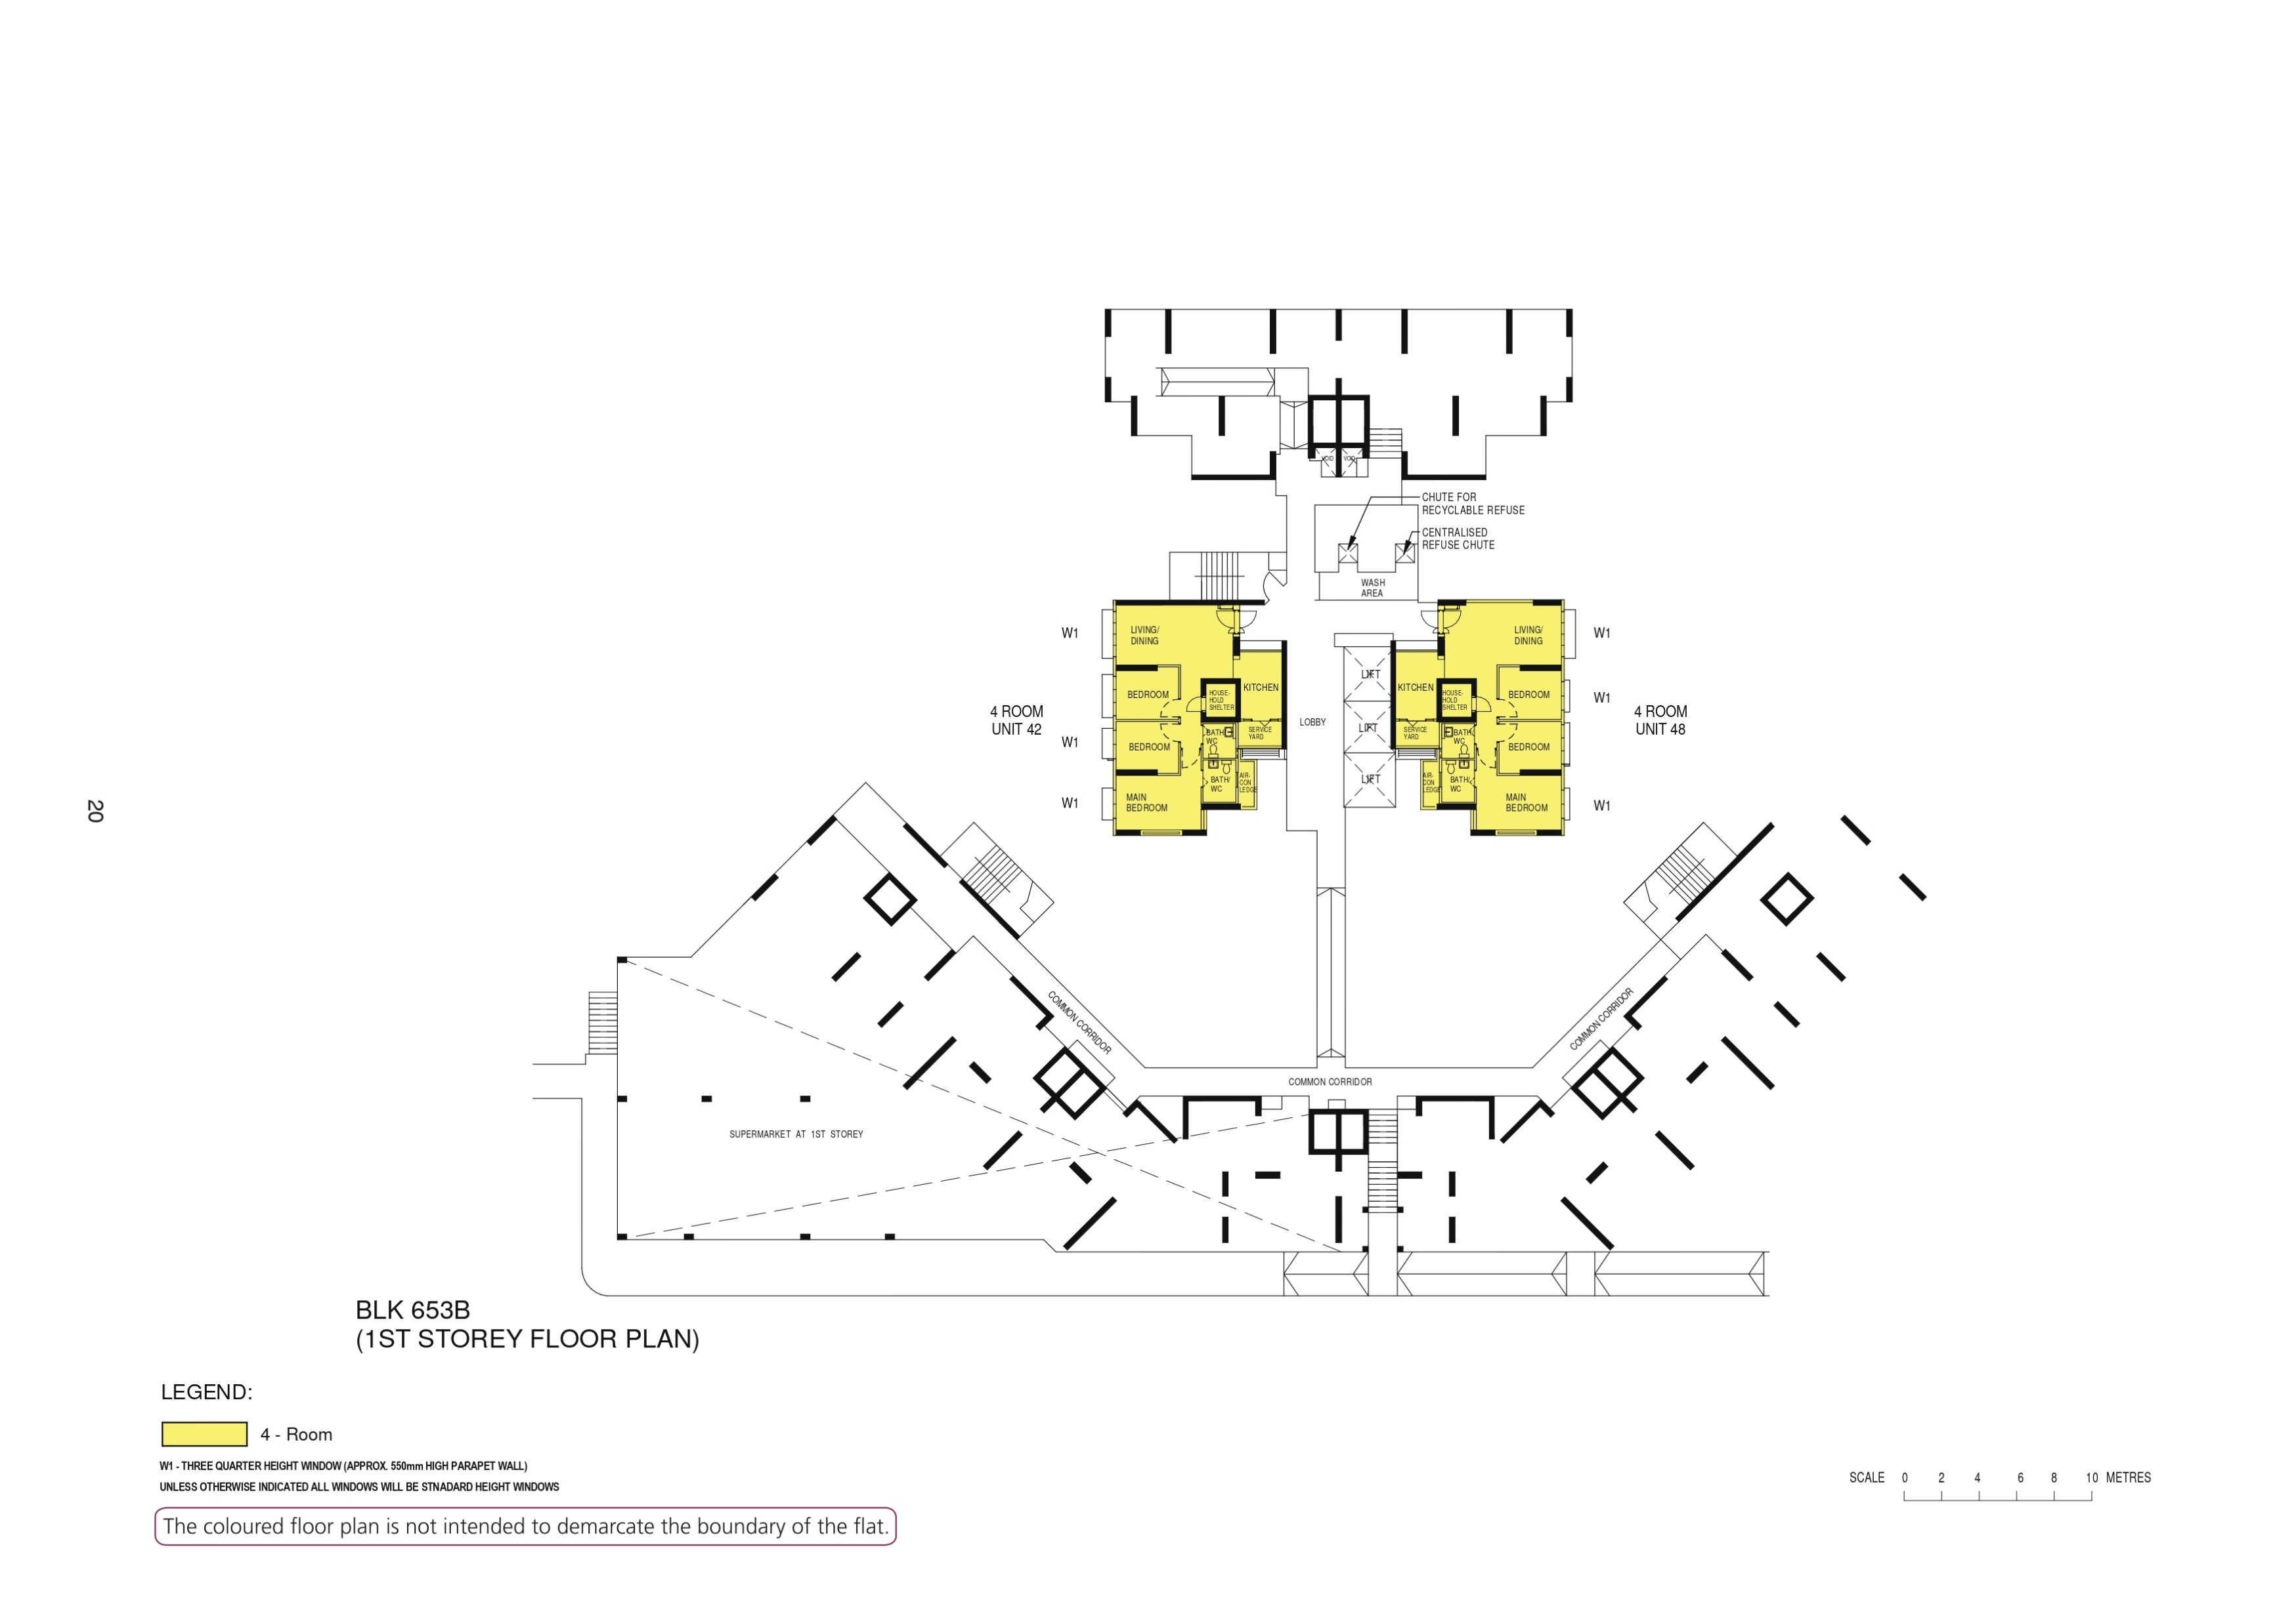

Slide 3
WASH
AREA
42
LOBBY
48
COMMON CORRIDOR
COMMON CORRIDOR
COMMON CORRIDOR

Slide 4
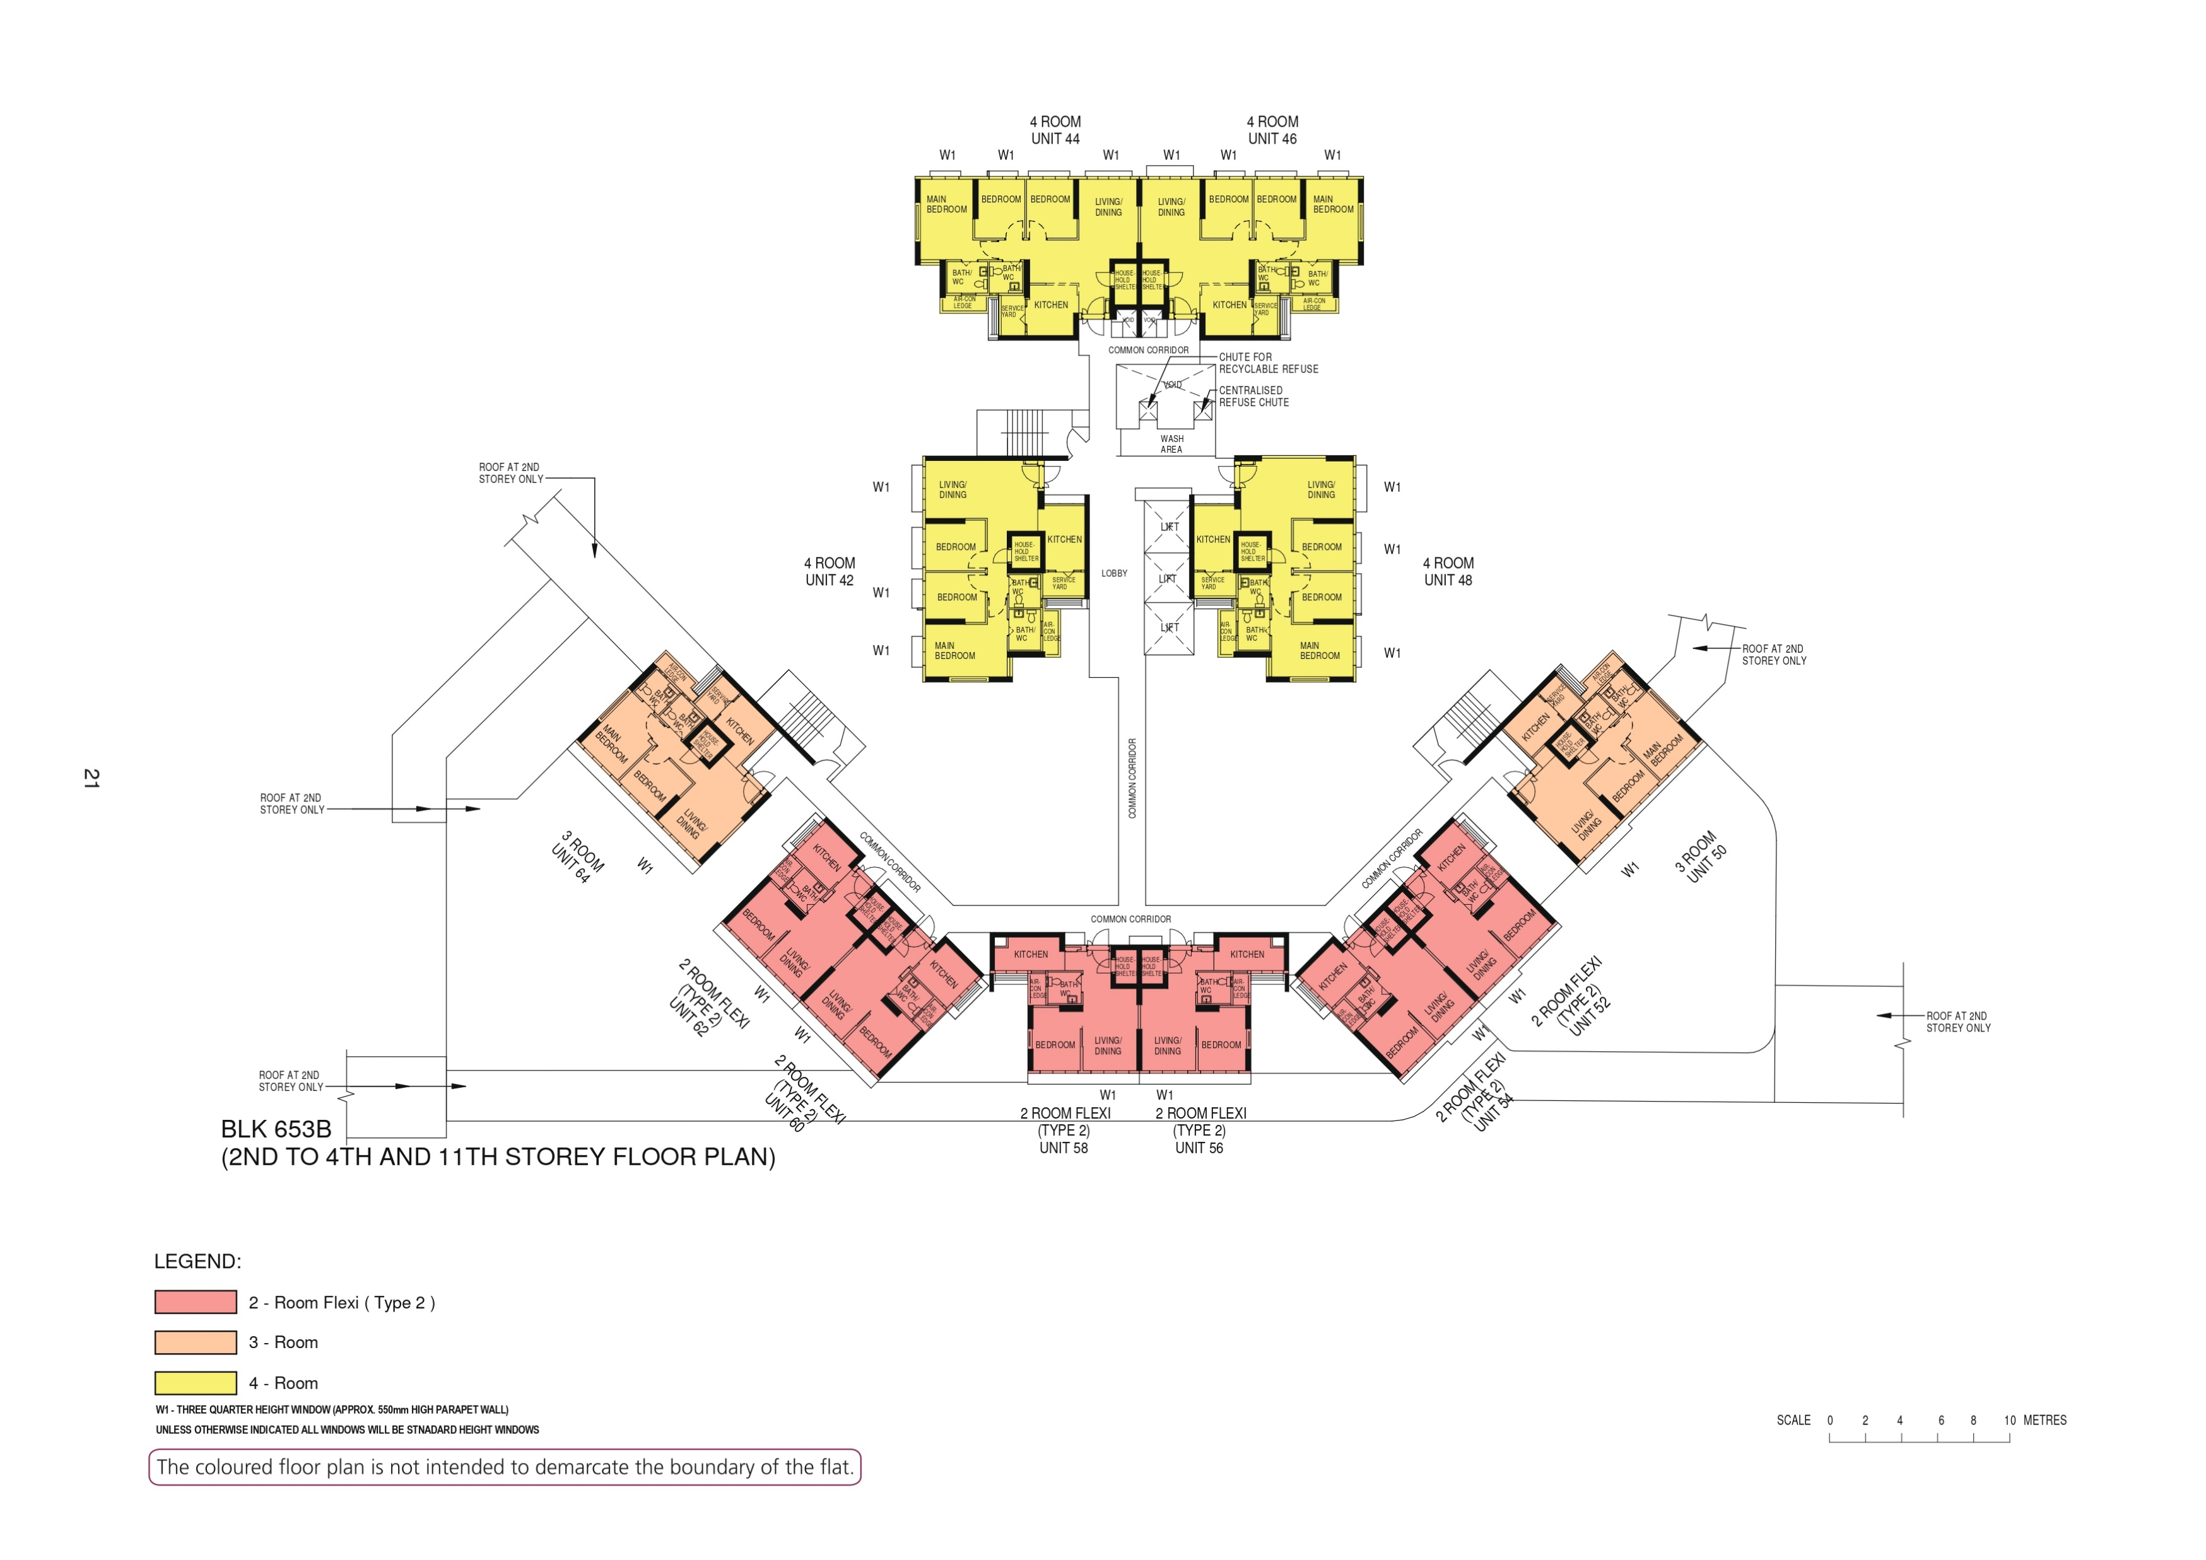

Slide 5
44
46
WASH
AREA
42
LOBBY
48
64
50
COMMON CORRIDOR
COMMON CORRIDOR
COMMON CORRIDOR
62
COMMON CORRIDOR
52
60
58
56
54

Slide 6
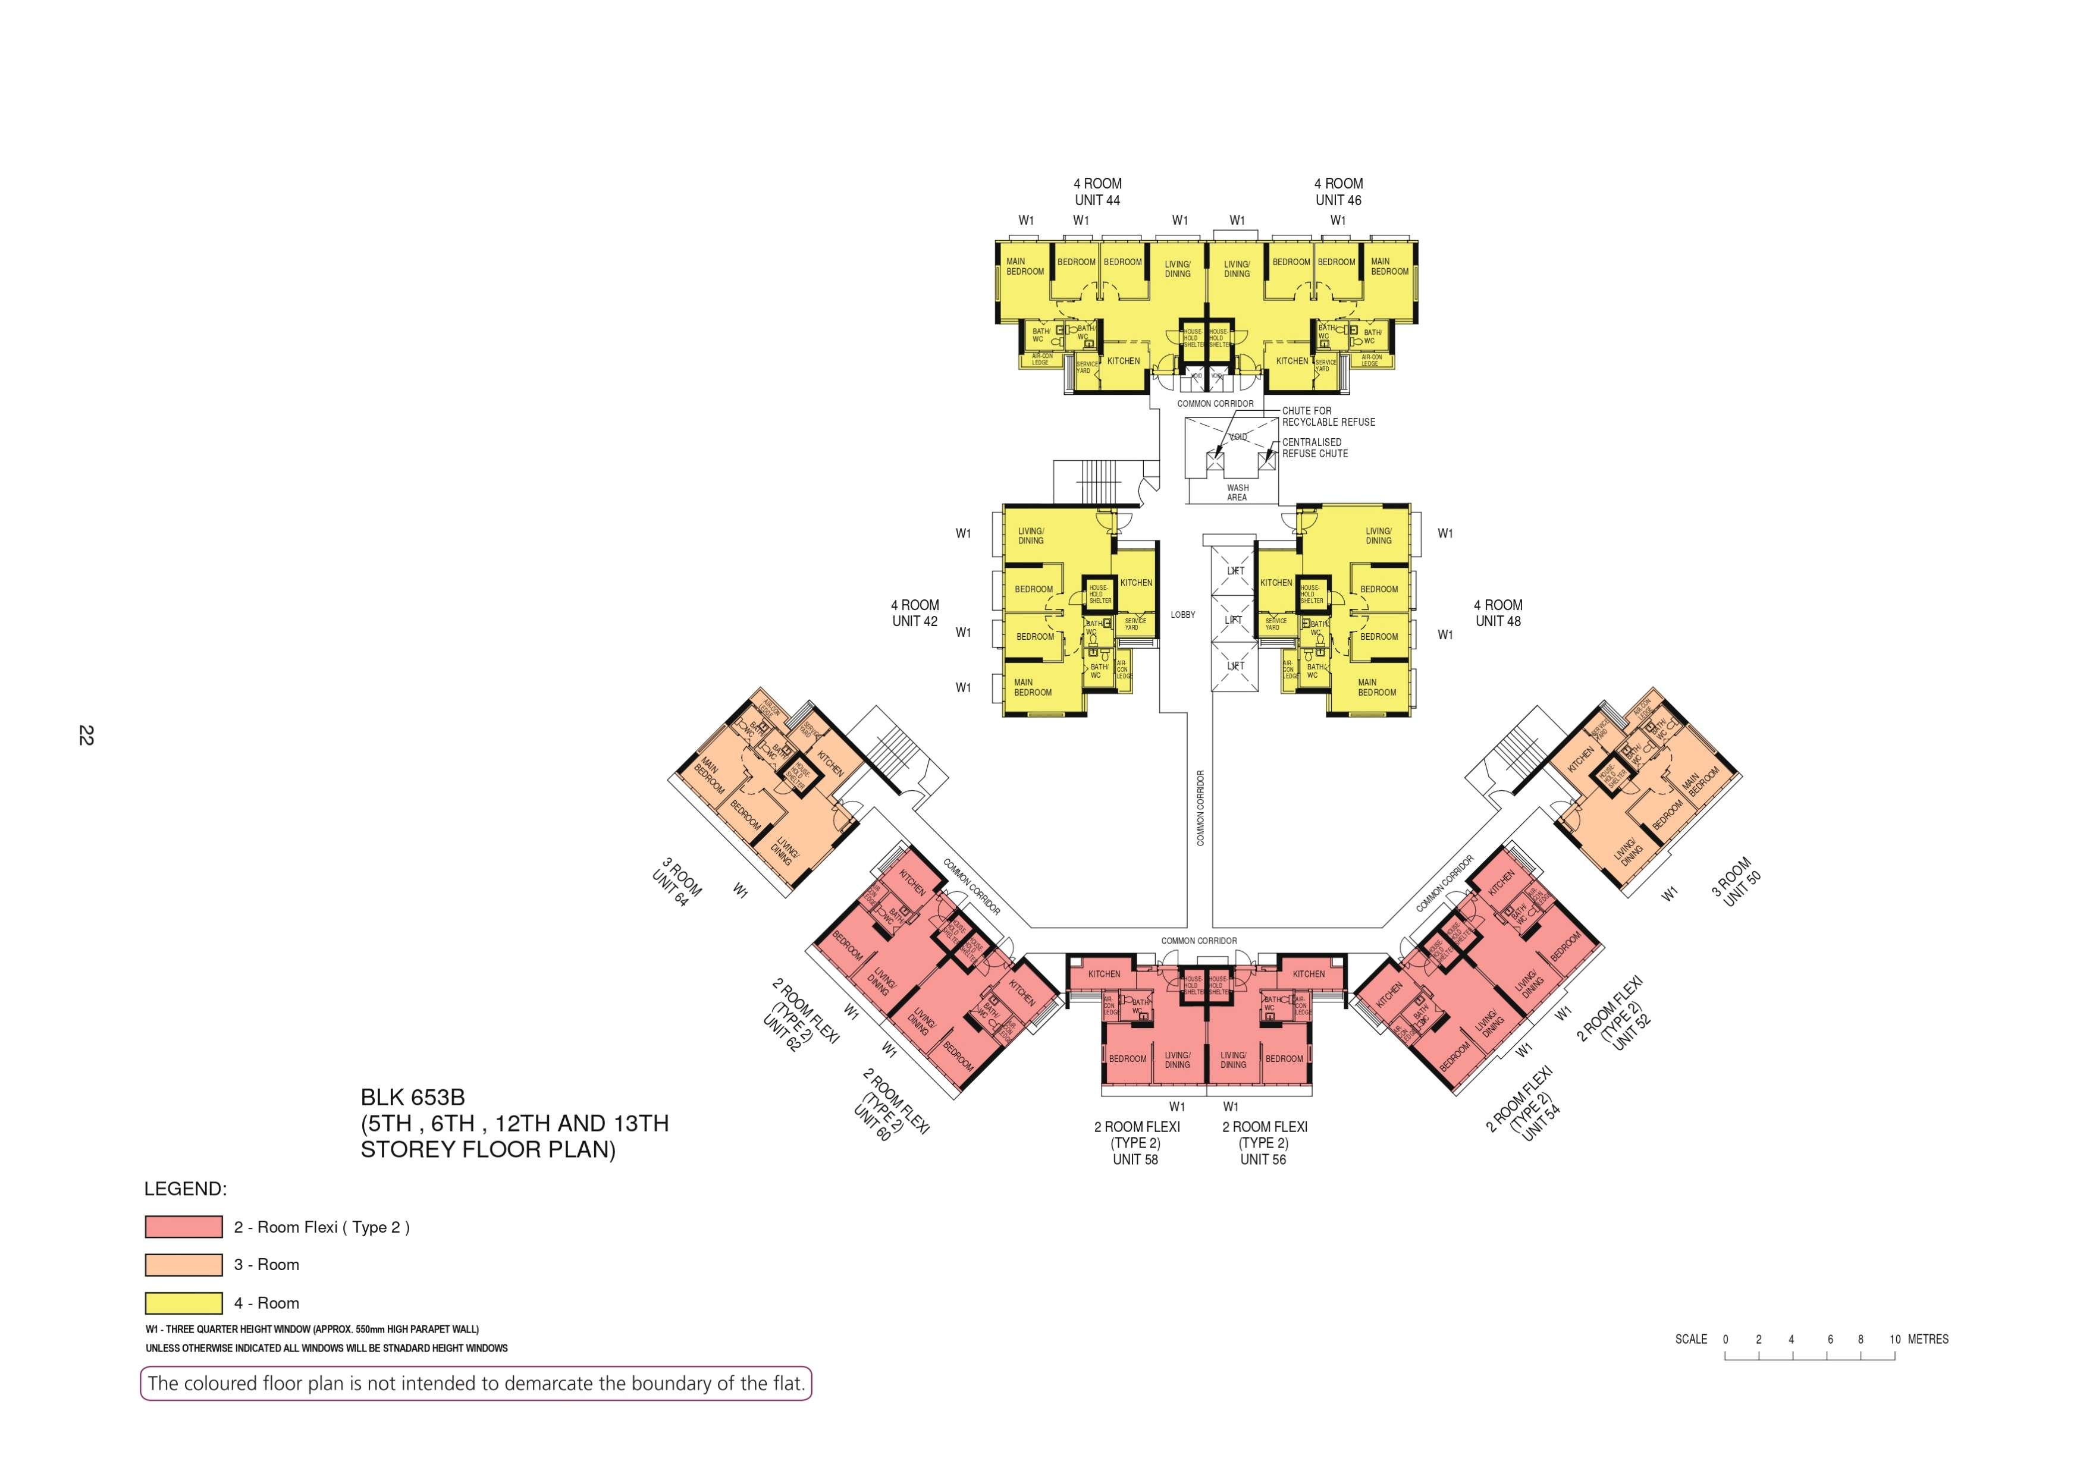

Slide 7
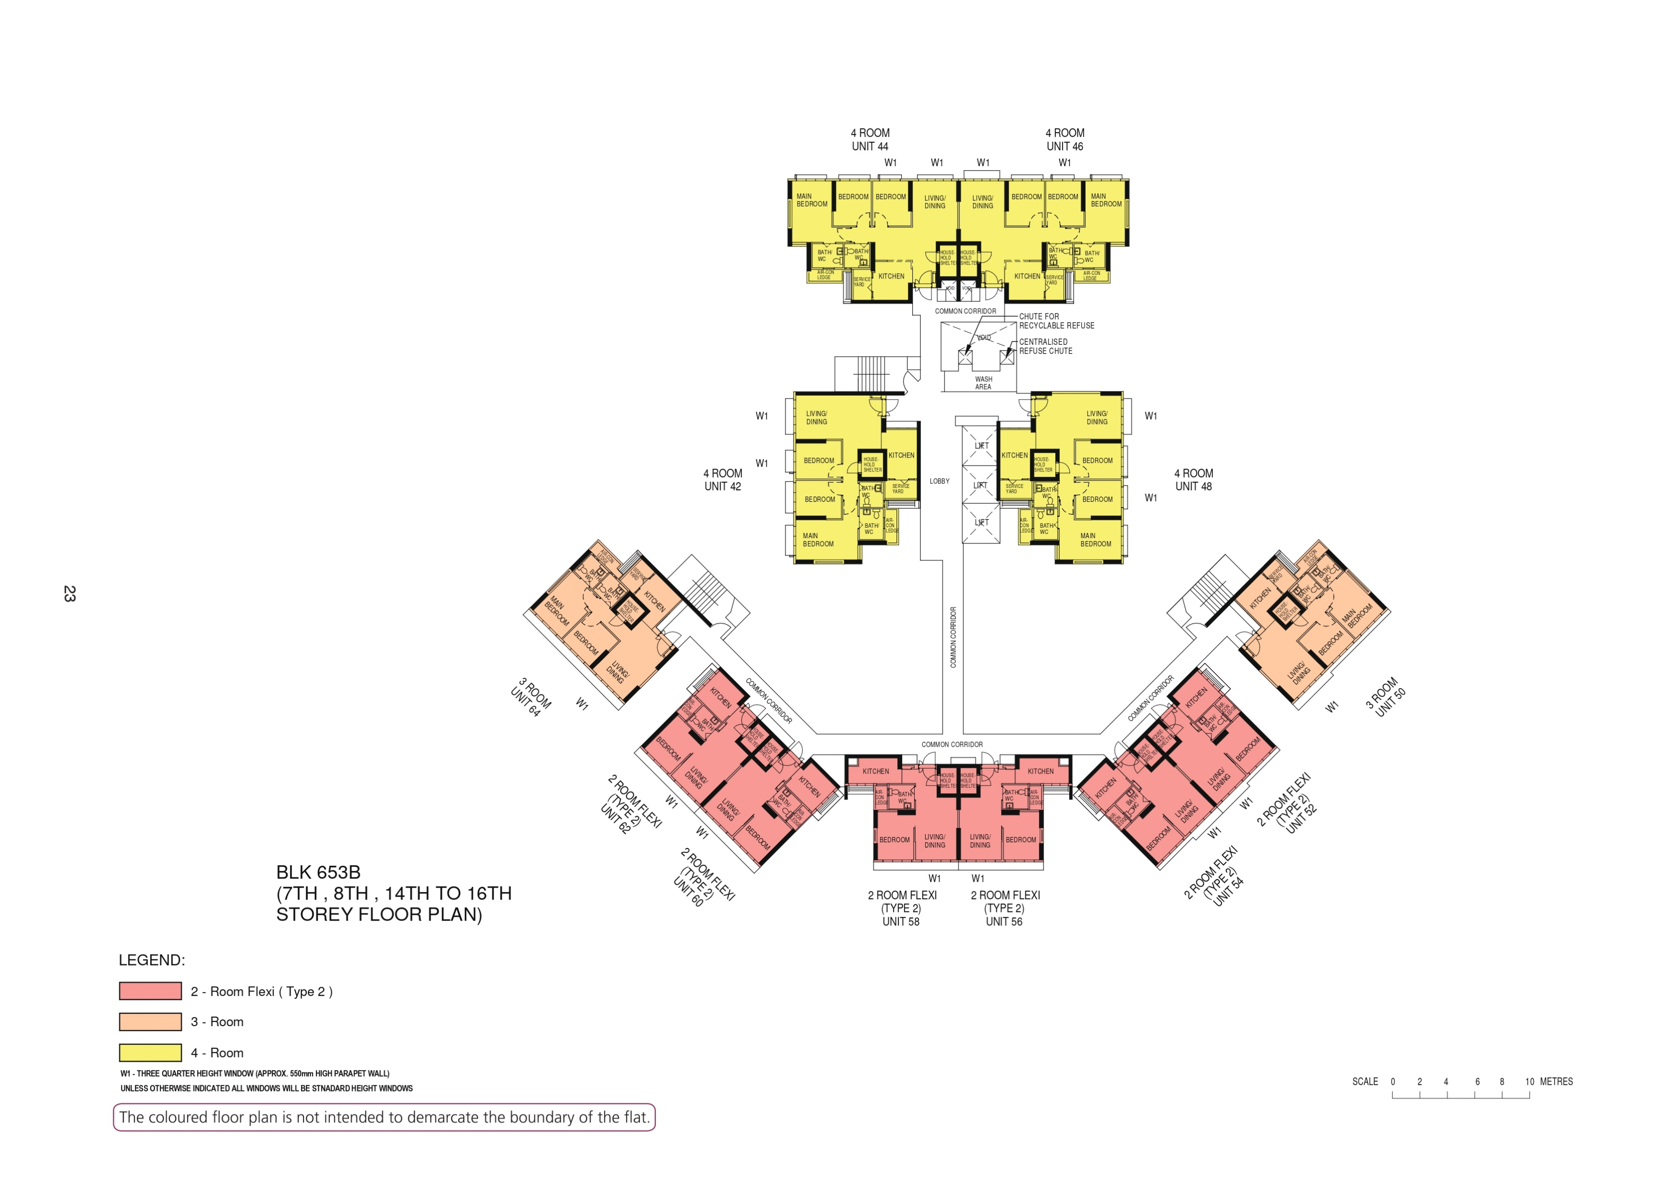

Slide 8
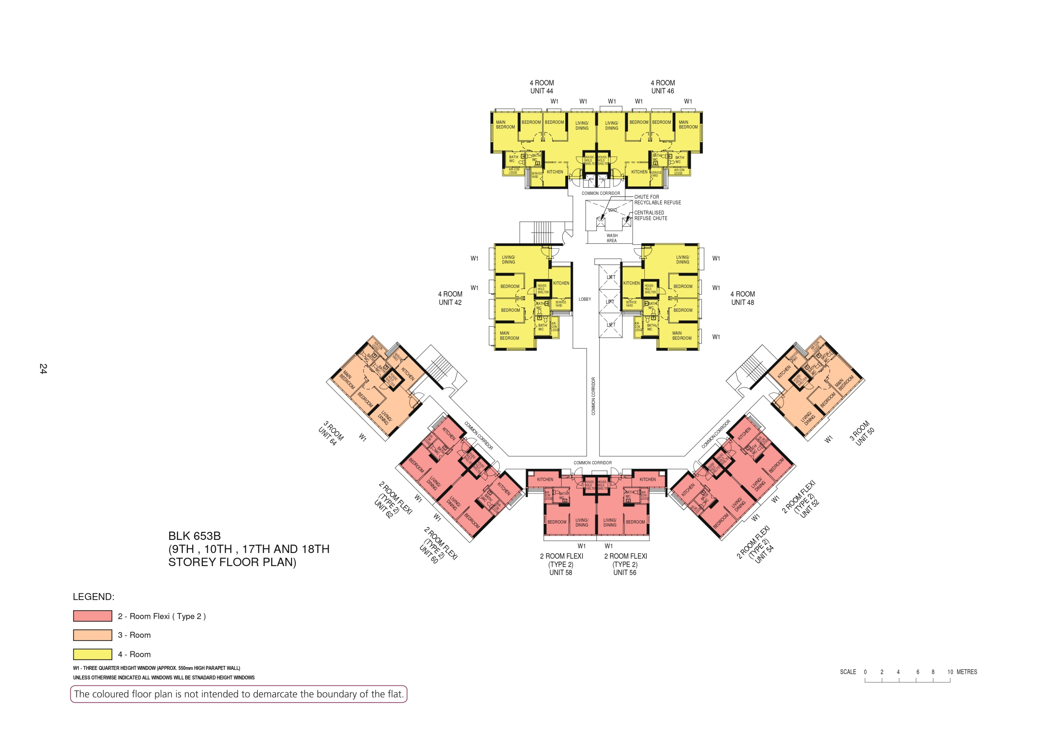

Slide 9
44
46
WASH
AREA
42
LOBBY
48
64
50
COMMON CORRIDOR
COMMON CORRIDOR
COMMON CORRIDOR
62
COMMON CORRIDOR
52
60
58
56
54

